Slide 1
Introduction to Azure Pipelines

Slide 2
Azure Pipelines
Unified Directory Structure: The .NET Engineering Services team streamlined development by consolidating all repositories under a shared directory structure, enhancing cross-stack navigation.
Common Commands and Logic: Developers benefited from standardized commands and build-and-test logic, facilitating seamless transitions across various software components.
Workflow Integration: Existing workflows from disparate CI systems were migrated to Azure Pipelines, unifying processes and enhancing productivity.
Managed System: By leveraging Azure Pipelines, the team offloaded the responsibility of maintaining CI server infrastructure, freeing up resources for other task

Slide 3
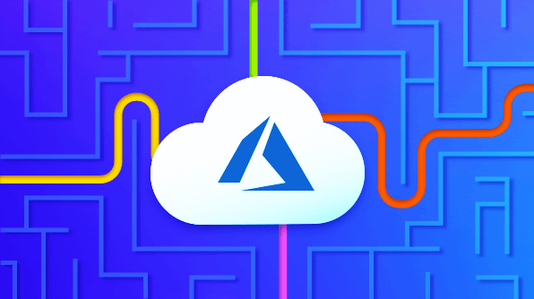
Advantages of Azure Pipelines
Works with any language or platform.
Deploys to different types of targets at the same time.
Builds on Windows, Linux, or Mac machines.
Combines with GitHub.
Works with open-source projects.

Slide 4
Thank You

